Slide 1
CSE 109 Electrical Circuits II
Dr. Md. Forkan Uddin
Associate Professor
Department of Electrical and Electronic Engineering (EEE)
Bangladesh University of Engineering and Technology (BUET)

Slide 2
Three Phase (3-φ) Balanced Circuit

Slide 3
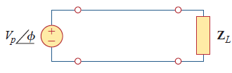
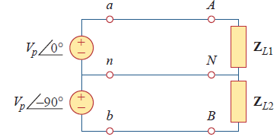
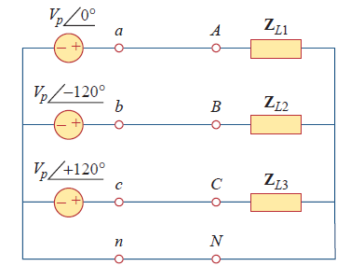
Different Systems
Single-phase two-wire system
Two-phase three-wire system
Phase difference: 90⁰
Three-phase four-wire system
Phase difference: 120⁰

Slide 4
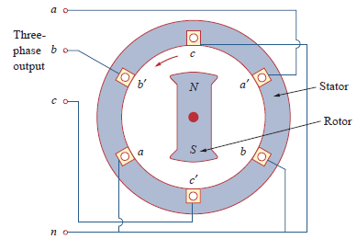
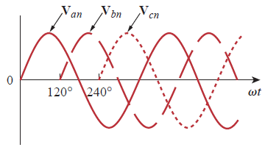
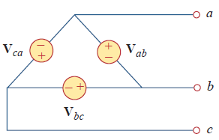
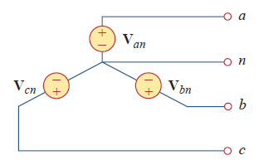


Balanced Three-Phase Voltages
Balanced system:
Equal magnitudes
Out of phase by 120⁰

Slide 5
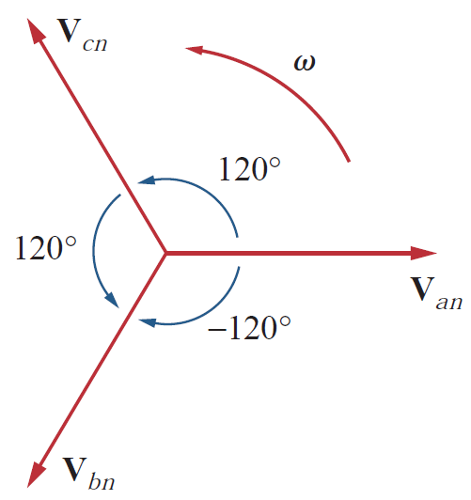
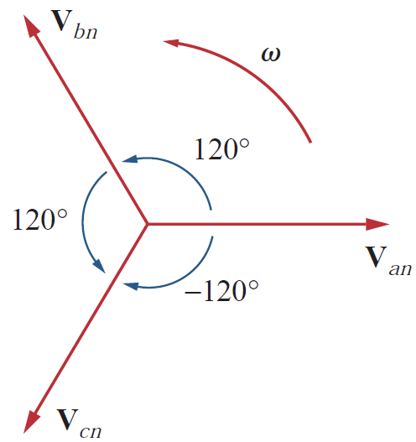
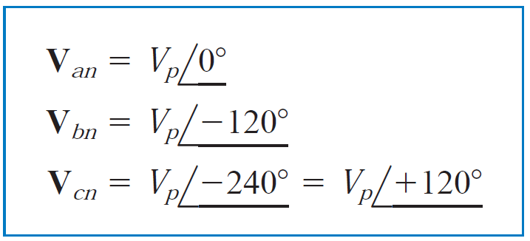
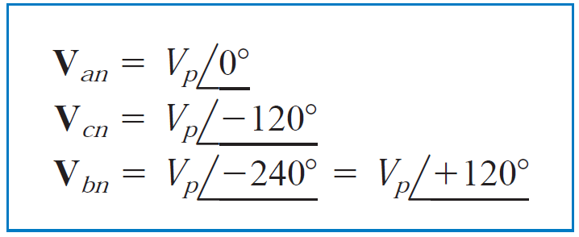
Phase Sequence
Since the three-phase voltages are out of phase with each other by 120º, there are two possible combinations
Sequence: abc or bca or cab
Sequence: acb or cba or bac

Slide 6
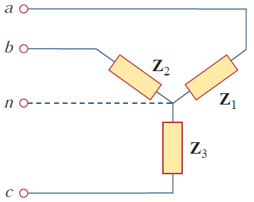
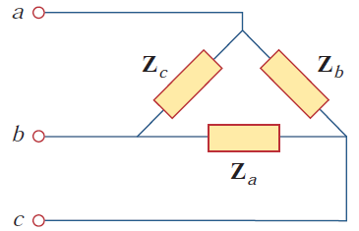


Balanced Load
A balanced load is one in which the phase impedances are equal in magnitude and in phase

Slide 7

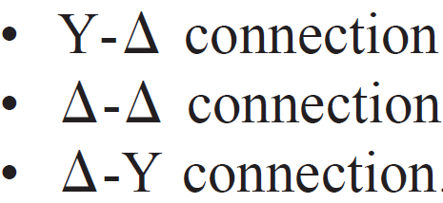
Combinations of Source and Load
Assumption for the following discussions:
Phase Sequence: abc

Slide 8
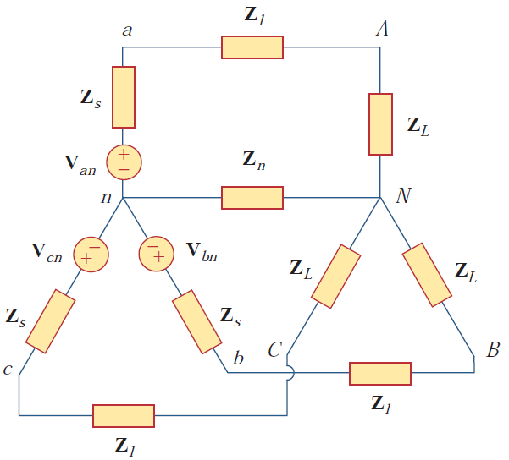
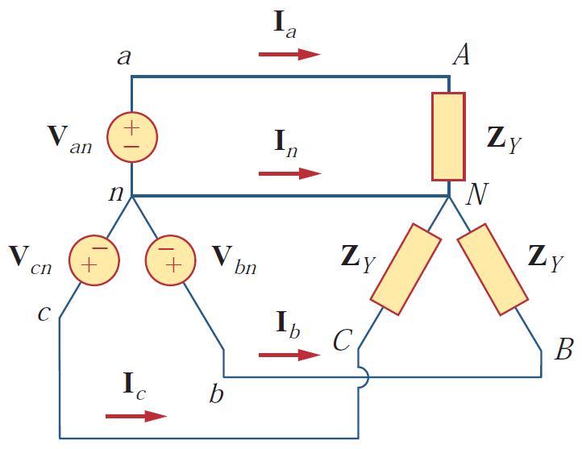

1. Balanced Y-Y Connection (1/3)
Total load impedance per phase
Z_{Y}
Total load impedance per phase

Slide 9
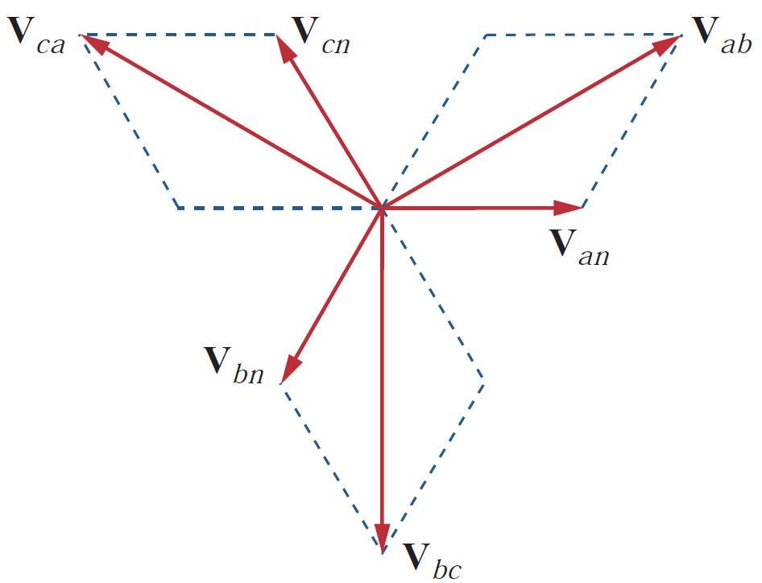
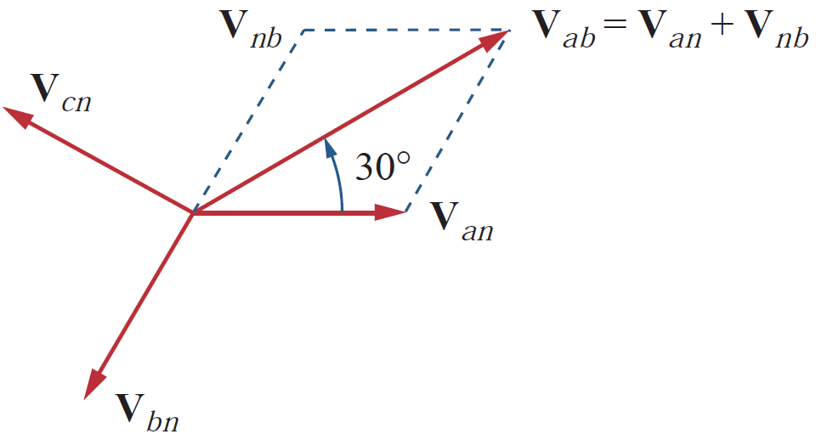
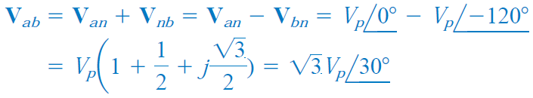
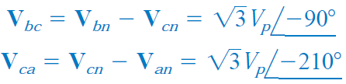
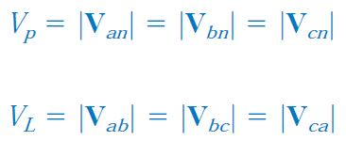
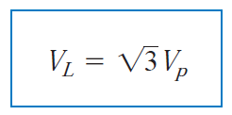
1. Balanced Y-Y Connection (2/3)
Voltages

Slide 10
1. Balanced Y-Y Connection (3/3)
For any Y-connection (source or load):
V_{L} = Line (line-to-line) voltage
V_{P} = Phase voltage
I_{L} = Line current
I_{P} = phase current
I_{L} = I_{P}

Slide 11
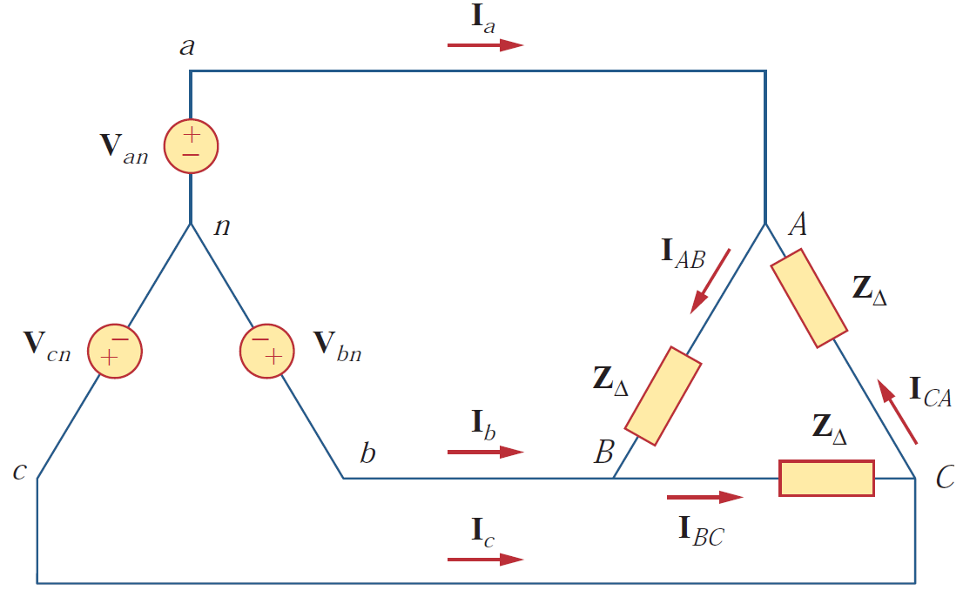




2. Balanced Y-Δ Connection (1/2)
This is the most practical three-phase system, as the three-phase sources are usually Y-connected while the three-phase loads are usually Δ-connected
Voltages (Similar to Y-Y)
I_{L} = I_{P}
Thus, for the Y-connected source:

Slide 12

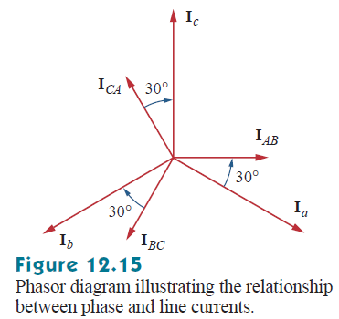


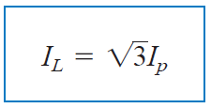
2. Balanced Y-Δ Connection (2/2)
Currents
V_{L} = V_{P}
For any Δ-connection (source or load):

Slide 13
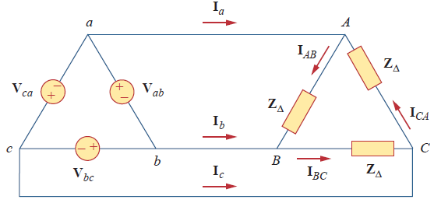
3. Balanced Δ-Δ Connection (1/1)
V_{L} = V_{P}
V_{L} = V_{P}
For source side:
For load side:

Slide 14
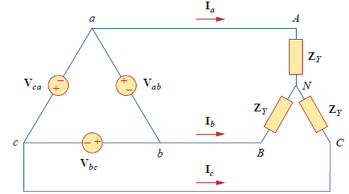
4. Balanced Δ-Y Connection (1/1)
V_{L} = V_{P}
For source side:
For load side:
I_{L} = I_{P}

